Slide 1
ISYS90048 Managing ICT Infrastructure
Malcolm Bertoni / Chris Keen
Department of Computing & Information Systems
Semester 2, 2018, Week 10

Slide 2
Teaching Session 10
Enterprise Architecture Frameworks
Role of Infrastructure Architect
© University of Melbourne 2018

Slide 3
Example: ICT Infrastructure Architectures
Double-ring Local Area Network Architecture for a University
Pre-existing ad hoc twisted pair campus network that failed on many occasions
Replaced by double ring fibre optic network, with fault tolerance and SNMP monitoring
Infrastructure architecture investment that is largely intact after 17 years
© University of Melbourne 2018

Slide 4
Example: ICT Infrastructure Architectures
Infrastructure SOA prompted for local government agency by new outsourced ERP system
LGA had already outsourced its regional networking, CRM and public information server
Decision to outsource their ERP system lead to a revision of entire ICT infrastructure, lead by the Corporate Services Manager
Service map for the whole organisation developed over a series of workshops
Service blueprints developed for key services
Produced an SOA architecture that focussed on quality of service delivery and enhanced flexibility in ICT infrastructure management
© University of Melbourne 2018

Slide 5
Enterprise architecture frameworks
An enterprise architecture framework (EA framework) defines how to create and use an enterprise architecture
It structures an architect’s thinking by dividing the architecture description into domains, layers, or views, and offers models - typically matrices and diagrams - for documenting each view
Enterprise architecture regards the enterprise as a large and as a complex system or system of systems
An architectural framework provides tools and approaches that help architects
There are many types of enterprise architecture frameworks
But there are six main ones
Refer to ISYS90043, Enterprise Applications & Architectures
© University of Melbourne 2018

Slide 6
Enterprise Architecture Alignment models
Given the complexity and challenges of enterprise architecture design and implementation, a number of methodologies have been developed:
The Zachman Framework – really a guide on organising documents, models and ICT policies; most widely known and referenced approach
ArchiMate – independent enterprise architecture modelling language
The Open Group Architecture Framework (TOGAF) – provides approaches to the design of business, application, data & technical architectures
Open Infrastructure Architecture (OIAm) – an open standard
The Federal Enterprise Architecture Framework – developed by the US government as models for business, service, components, technical, and data aspects of an enterprise architecture
US Department of Defense Architecture Framework (DoDAF)
Ref: Urbaczewski, L & Mrdalj, S (2006) “A Comparison of Enterprise Architecture Frameworks”, Issues in Information Systems, Vol 12, No. 2, p18.
© University of Melbourne 2018

Slide 7
Enterprise Architecture Principles
Business Principles
Architectural principles will apply to the whole of the organisation
Architectural decision must comply with all laws & regulations
Architectural decisions must deliver maximum benefit to the organisation
Information management is the prime purpose of ICT, so all key stakeholders should be involved in IM-based architectural decisions
Architectural designs must ensure a given level of business continuity
Wherever possible, applications should be chosen with maximum usage across the organisation
The ICT unit is responsible for managing and implementing all ICT processes and infrastructure that support business functions in the organisation
© University of Melbourne 2018

Slide 8
Enterprise Architecture Principles
Information Principles
All classified information must be kept secure, confidential and protected from unauthorised usage
Information is an asset that should be actively managed by the organisation
Information ownership and usage should be appropriately shared across the organisation
Information needs to be available when and where authorised users require it for their applications
Information quality is the responsibility of designated officers (trustees)
Value should be able to derived through data mining and data analysis as appropriate
© University of Melbourne 2018

Slide 9
Enterprise Architecture Principles
Application Principles
Wherever possible applications should be chosen to be independent of specific technology and specific technology platforms
Applications should be chosen to maximise their ease of use, consistent with meeting their functional requirements
Wherever possible purchase rather than develop suitable applications – conduct realistic Make-Buy analysis of each new purchase
© University of Melbourne 2018

Slide 10
Enterprise Architecture Principles
Technology Principles
All changes in technology must only be driven by changes/advances in business needs
All technological development must be business-aligned and strategically-aligned
Diversity of technology should be minimised in the organisation to minimise the cost of maintaining multiple platforms/applications and to enhance interoperability
Refer: Plymouth University (2018) Enterprise Architecture Principles – Introduction, available at http://blogs.plymouth.ac.uk/strategyandarchitecture/enterprise-architecture-with-plymouth-university/plymouth-university-architecture-repository-2/enterprise-architecture-principles/
© University of Melbourne 2018

Slide 11
Enterprise Architecture Challenges
Collaboration
An enterprise architect needs to collaborate and work productively with a wide range of associates, from business, technology and other application backgrounds
They need to be able to negotiate complex EA solutions, often before anyone has a clear understanding of what will be delivered
Tools
An enterprise architect needs to be have access to the most appropriate tools for modelling, analysis, monitoring, communicating and achieving economies of scale in large, complex systems
Skill Sets
An enterprise architect needs to have an increasingly broad range of skills, including technical knowledge, design & engineering skills, investment & financial analysis, and the soft skills required to work productively with others
© University of Melbourne 2018

Slide 12
Enterprise Architecture Challenges
ICT Governance
An enterprise architect needs to know ICT governance frameworks, and be able to use them productively in the design and management of ICT infrastructure
They need to be able to formulate and evaluate ICT governance policies – the rules and guidelines by which ICT will be utilised in the organisation
Outsourcing and Cloud Contracting
An enterprise architect needs to be plan and manage outsourced ICT contracts, and productively employ service-based cloud (X-as-a-service) solutions for the organisation
Refer TIBC Scribe (2018), available at https://www.scribesoft.com/blog/2018/03/five-major-challenges-enterprise-architects-overcome/
© University of Melbourne 2018

Slide 13
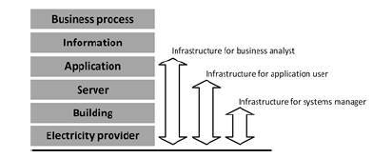
Infrastructure Architecture
IT infrastructure consists of the equipment, systems, software, and services used in common across an organization, regardless of mission/program/project.
Refer Sjaak Laan (2017) IT Infrastructure Architecture – Infrastructure Building Blocks and Concepts, 3rd Ed, Lulu Press Inc.
© University of Melbourne 2018

Slide 14
Modular Infrastructure Architecture
This approach seeks to design and evaluate infrastructure architecture using well defined modular components.
Example, consider a simple web server, with database system backend:
As the load increases, more web servers are added to cope with the user demand:
Refer Sjaak Laan (2017) IT Infrastructure Architecture – Infrastructure Building Blocks and Concepts
Storage devices
Web server
Application server
Database server
Storage area network
Storage devices
Storage devices
Storage devices
Web server
Storage devices
Web server
Application server
Database server
Storage area network
Storage devices
Storage devices
Storage devices
Web server
© University of Melbourne 2018

Slide 15
Modular Infrastructure Architecture
Example continued:
The Database server is now the bottleneck, so as load increases, additional Database servers are added:
Web server
Database server
Storage devices
Web server
Application server
Database server
Storage area network
Storage devices
Storage devices
Storage devices
Web server
Database server
© University of Melbourne 2018

Slide 16
Modular Infrastructure Architecture
Example continued:
However, the 2 additional Database servers do not increase the performance by x 3. The workload on the system needs to be distributed across the available servers using a Load balancer, which determines which server will receive each request, based on the current load and characteristics of each request. Load balancers may be needed to handle requests at each processing stage in this system.
Web server
Database server
Storage devices
Load balancer
Web server
Application server
Database server
Storage area network
Storage devices
Storage devices
Storage devices
Web server
Database server
© University of Melbourne 2018

Slide 17
Modular Infrastructure Architecture
This example illustrates:
Meaningful infrastructure architecture design can be undertaken using known, well defined, modular components, that are technology independent
This architecture can be communicated to technology implementers who can complete the detail design, testing, implementation and monitoring, without deviating from the high level conceptual design
Realistically, this architectural design requires detailed requirement specifications, an understanding of the available technological components, and an understanding of the logical and mathematical nature of the problem, just as required in any other branch of engineering
In this example, the unit of request is a user call on the web server, and the nature of HTTP is that it allows separability of individual requests, so that each subsequent request can be processed by any of the servers in the system
A detailed knowledge of queueing theory and user load simulation would be required to design the detailed systems and to determine the load capacity required of the servers
The architectural model form the basis of the business case, the conceptual model of the administrators and basis on which performance monitoring of the system will be reported and understood.
© University of Melbourne 2018

Slide 18
Open Infrastructure Architecture Method (OIAm)
OIAm, the Open Infrastructure Architecture method, is a an open standard for the application of architecture to infrastructure
It is an open modelling language for enterprise architecture and consists of:
ArchiMate architecture modelling language based on functionality
Standardised content with a community-based reference architecture
A workflow/methodology for defining OIAm
Refer Open Infrastructure Architecture Repository, available at https://www.infra-repository.org/oiar/index.php/The_infrastructure_landscape
© University of Melbourne 2018

Slide 19
Open Infrastructure Architecture Overview
OIAm is still evolving
OIAm seeks to develop commonly used building blocks, particularly for the finance industry
OIAm contains architectural components and design guidelines for the construction of models of IT infrastructure from an architectural perspective
OIAm is heavily influenced by SOA, and provides a higher level of categorisation of service building blocks than SOA
While OIAm has a well-defined structural basis, it is less well defined in terms of its design methodologies
Ref. Schooderbeek, J, Jumelet, D & Reimann, R (2013) Introduction to the Open Infrastructure Architecture method (OIAm), BIZZdesign white paper, available in readings for session 08
© University of Melbourne 2018

Slide 20
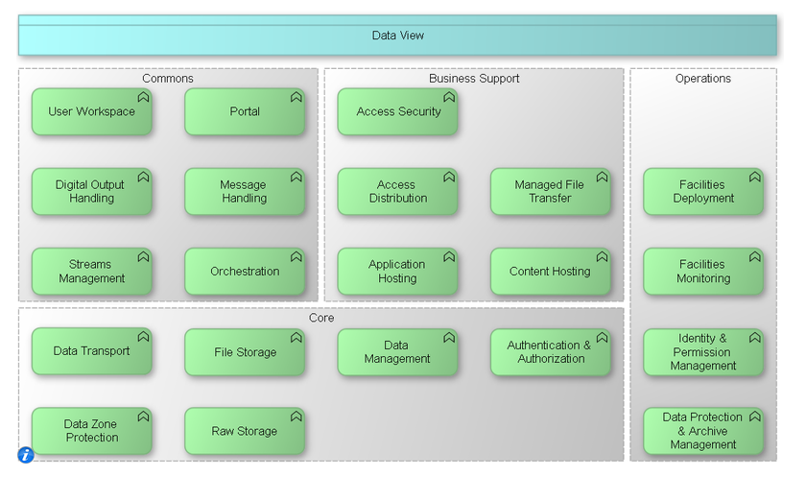
OIA – Typical components
© University of Melbourne 2018

Slide 21
Open Infrastructure Architecture Method (OIAm)
OIAm has Generic Functions that are the basic building blocks of OIA models
Each function has an associated description, and an icon
More than fifty infrastructure functions that explains what they do
The set of infrastructure function covers just about everything that the infrastructure architects need to describe functions, eg: ‘filtering’ (what a firewall does)
© University of Melbourne 2018

Slide 22
ArchiMate
ArchiMate: an open and independent enterprise architecture modelling technique (language) for describing enterprise architectures
ArchiMate is a unified way of modelling enterprise architectures, integrating the various domains and describing them in an easily readable way
It presents a clear set of concepts within and relationships between architecture domains and offers a simple and uniform structure for describing the contents of these domains
Distinguishes between objects at the following layers:
Business Layer
Application Layer
Technology Layer
Implementation & Migration Layer
© University of Melbourne 2018

Slide 23
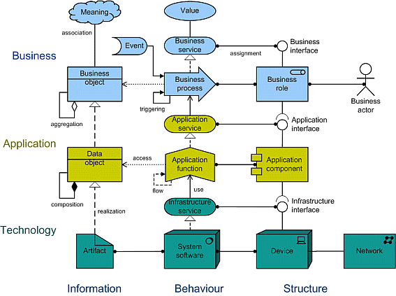
ArchiMate concepts
The most important concepts of ArchiMate are shown below
© University of Melbourne 2018

